Slide 1

API Testing Graduation Project
Wessam Abdulrhman

Slide 2

Agenda
What is API ?
Types of API.
Web Service APIs.
Major Types of Web Services.
Examples of API Testing Tools.
Project by Postman.
Demo Using Postman& Newman

Slide 3

What is API ?
API Stands for Application Programming Interface.
API’s allows two applications to communicate with each other.
A piece of code is talking to another piece of code with any Programming languages.
It is a contract between the client and server.
Client sends a request through the API and after performing the action the API will send back a response to the client.

Slide 4
3-Tiers Architecture Concept
Presentation Layer
Business
Layer
Data Access Layer
User Interface: Web, Mobile, Desctop Apps
Appication Programming Interface
DataBase

Slide 5
What is API ?
APIs can be use for:
Communication between services.
Example : Bank Transactions through third party apps.
Access inbuilt hardware of a device.
Example : access camera in a mobile.
Application
Assets

Slide 6
Types of APIs:
Public APIs
Partner APIs
Private APIs
Public APIs are open and available for use by any outside developer or business.
Examples: Weather Apps, Ecommerce, etc.…
A partner API, only available to specifically selected and authorized outside developers or API consumers, is a means to facilitate business-to-business activities.
Examples: Amazon Selling Partner API.
Private APIs, also known as internal or closed APIs, are application programming interfaces that are intended for use within a specific organization or company.
Examples: Financial Apps, Netflix, etc.

Slide 7

Web Services APIs
Non-Web Services APIs
All web services are APIs.
Need a SOAP protocol to send or receive data over the network.
It provides supports only for the HTTP/ HTTPS protocol.
Web service uses three styles: REST, SOAP, and XML-RPC for communication.
Communication between two layers without the need for the network.
Example: Windows services, computer hardware using set of rules& protocols.

Slide 8
Web Services APIs
All Web Services are APIs.

Slide 9
SOAP
SOAP stands for Simple Object Access Protocol.
A format for sending and receiving messages.
SOAP is platform independent.
The best way to communicate between applications is over HTTP.
SOAP provides a way to communicate between applications running on different operating systems, with different technologies and programming languages.

Slide 10
Building Blocks of SOAP
A SOAP message is an ordinary XML document which contains:
An Envelope : identifies the XML document as a SOAP message
A Header : contains header information
A Body : contains call and response information
A Fault : contains errors and status information

Slide 11
REST
REST stands for REpresentational State Transfer.
REST structures data in XML, Json, or any other format that is
Usually JSON is the most widely used format.

Slide 12
Compare SOAP vs REST
SOAP
REST
Is a protocol.
SOAP can’t use REST because it is a protocol.
Permits only XML..
Requires more bandwidth and more resources.
SOAP is more reliable than REST.
SOAP is slower than REST.
SOAP defines its own security.
Is an architectural style.
REST can use SOAP web services because it is a concept and can use any protocol like HTTP, SOAP.
Permits many different data formats including plain text, HTML, XML, and JSON.
Requires less bandwidth and less resources.
REST is less secure but faster than SOAP.
RESTful web services inherit security measures from the underlying transport.

Slide 13
Basic REST HTTP Methods
GET : read or retrieve data.
POST : add new data.
PUT : update existing data.
DELETE : delete data.

Slide 14





Examples of API Testing Tools:
Postman
Rest-assured
Best Suited For Exploratory, Manual, And Automation Testing.
Easy User Interface.
A Java Library For Performing Automated API Testing.
Fiddler
Katalon
JMeter
offers a desktop application with a robust and feature-rich user interface.
End-to-end test automation solution that supports multiple types of testing include API.
Java application.

Slide 15

API Testing Project
Conducting end-to-end API testing for XYZ Company's Employee Management System.
“By Postman Tool”

Slide 16
Requirements
Employee ID can not be blank, ID can be only numbers.
Employee first and last name must not be blank.
Employee’s mobile number format contains only number.
Employee’s mobile number is 11 digits.
Employee’s email can not be blank and format must be valid.
Employee’s salary is only numbers.
Get, Post, Delete and Put Methods response time must be less that 200 ms.

Slide 17
End-to-End Scenario with Valid Data
By Postman

Slide 18
Project Collection
1- E2E Scenario with Employee Valid Data
Test Data for POST Req.:
{"id": "21",
"first name": "Mohamed",
"last name": "Sherif",
"title": "Sales",
"mobile number": "01121980076",
"email": "mohamed.sherif@gmail.com",
"salary": "6500"
}
Test Data for PUT Req.:
{
"id": "27",
"name": "Murad Ahmed",
"title": "sales manager",
"email": "murad.ahmed@gmail.com",
"salary": "9000"
}
POST: Add Employee
GET: Get Employee by ID
PUT: Edit Employee
DELETE: Delete Employee
GET: Get Employee after Delete

Slide 19
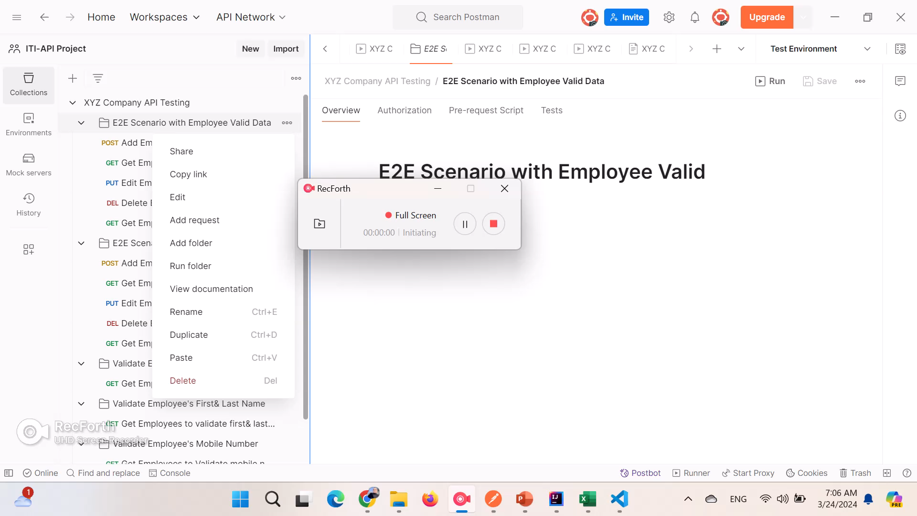

Slide 20
End-to-End Scenario with Invalid Data
By Postman

Slide 21
Project Collection
1- E2E Scenario with Employee inValid Data
POST: Add Employee
GET: Get Employee by ID
PUT: Edit Employee
DELETE: Delete Employee
GET: Get Employee after Delete
Test Data for POST Req.:
{"id": "xx",
"first name": "",
"last name": "",
"title": "Sales",
"mobile number": "011xx980076",
"email": "mohamed.sherifgmail.com",
"salary": "650xx0"
}
Test Data for PUT Req.:
{
"id": "27",
"name": "Murad Ahmed",
"title": "sales manager",
"email": "murad.ahmed@gmail.com",
"salary": "9000"
}

Slide 22
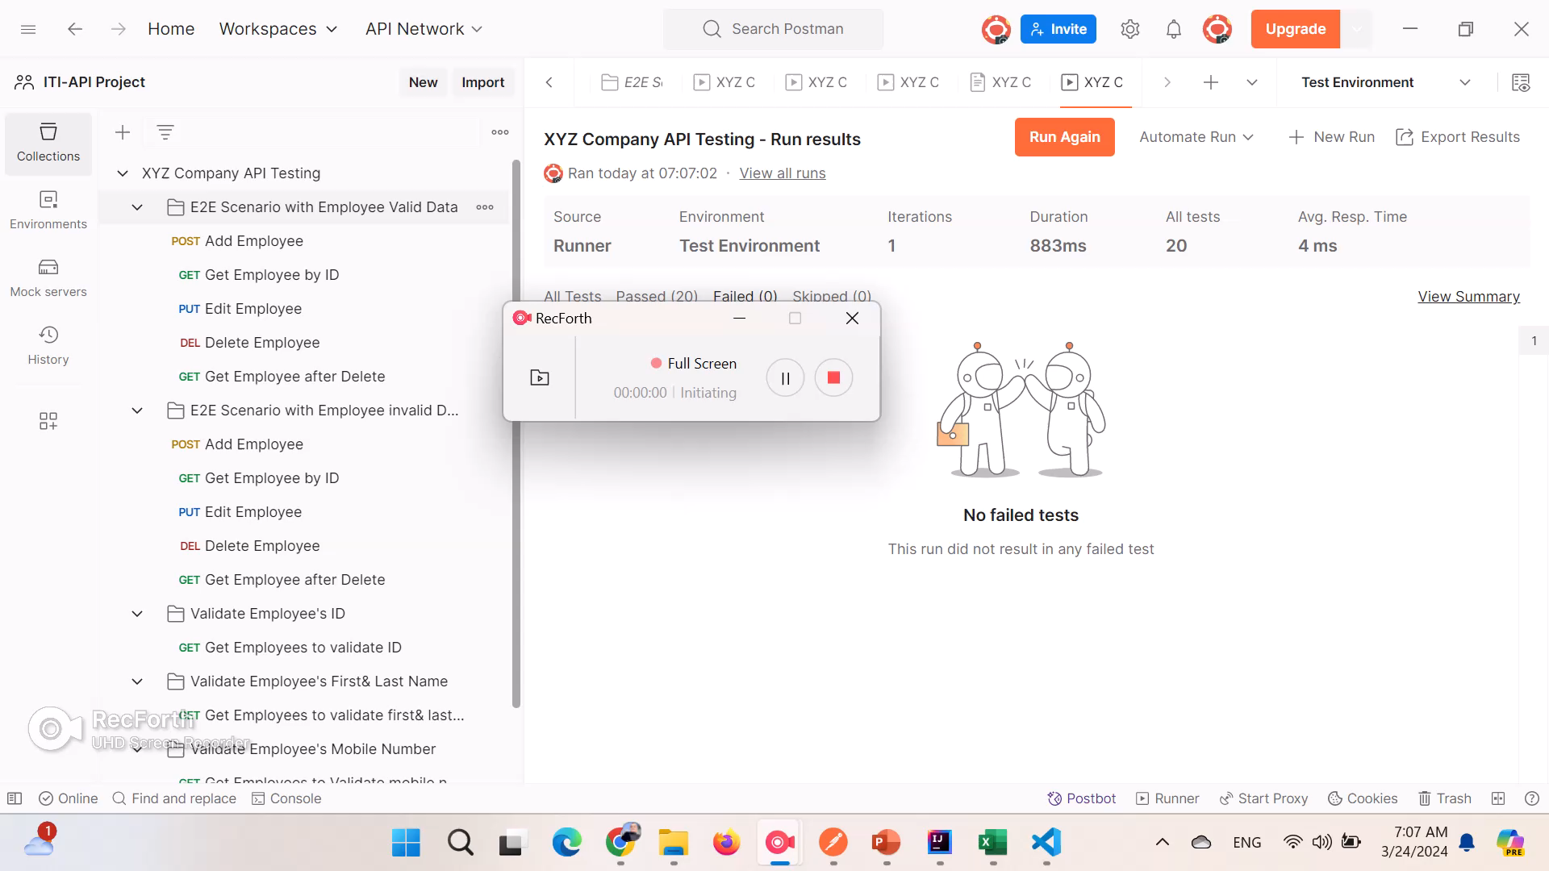

Slide 23
Folder to Validate Employee’s Data
By Postman

Slide 24
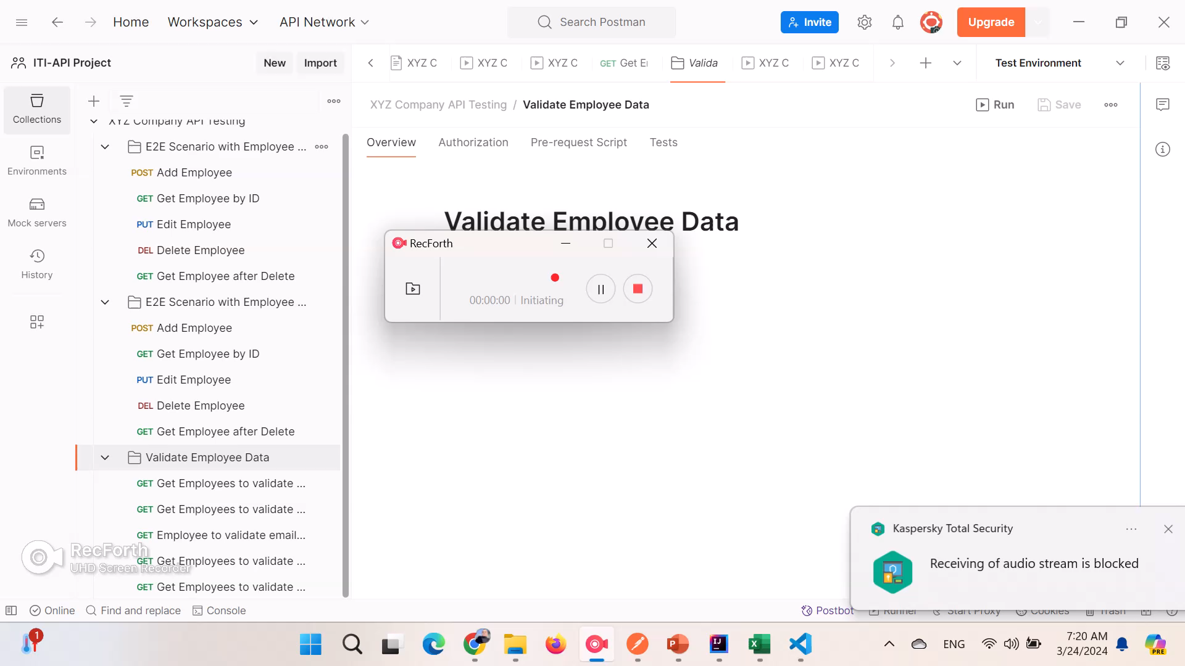

Slide 25
Folder to Validate Employee’s Data
By Postman& Newman

Slide 26
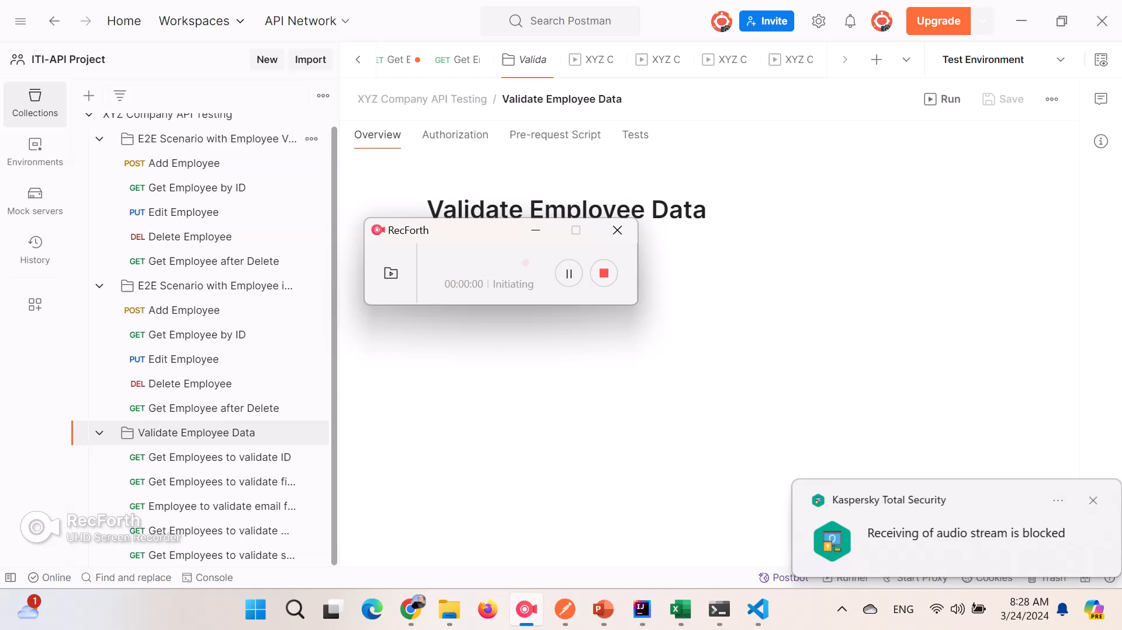

Slide 27
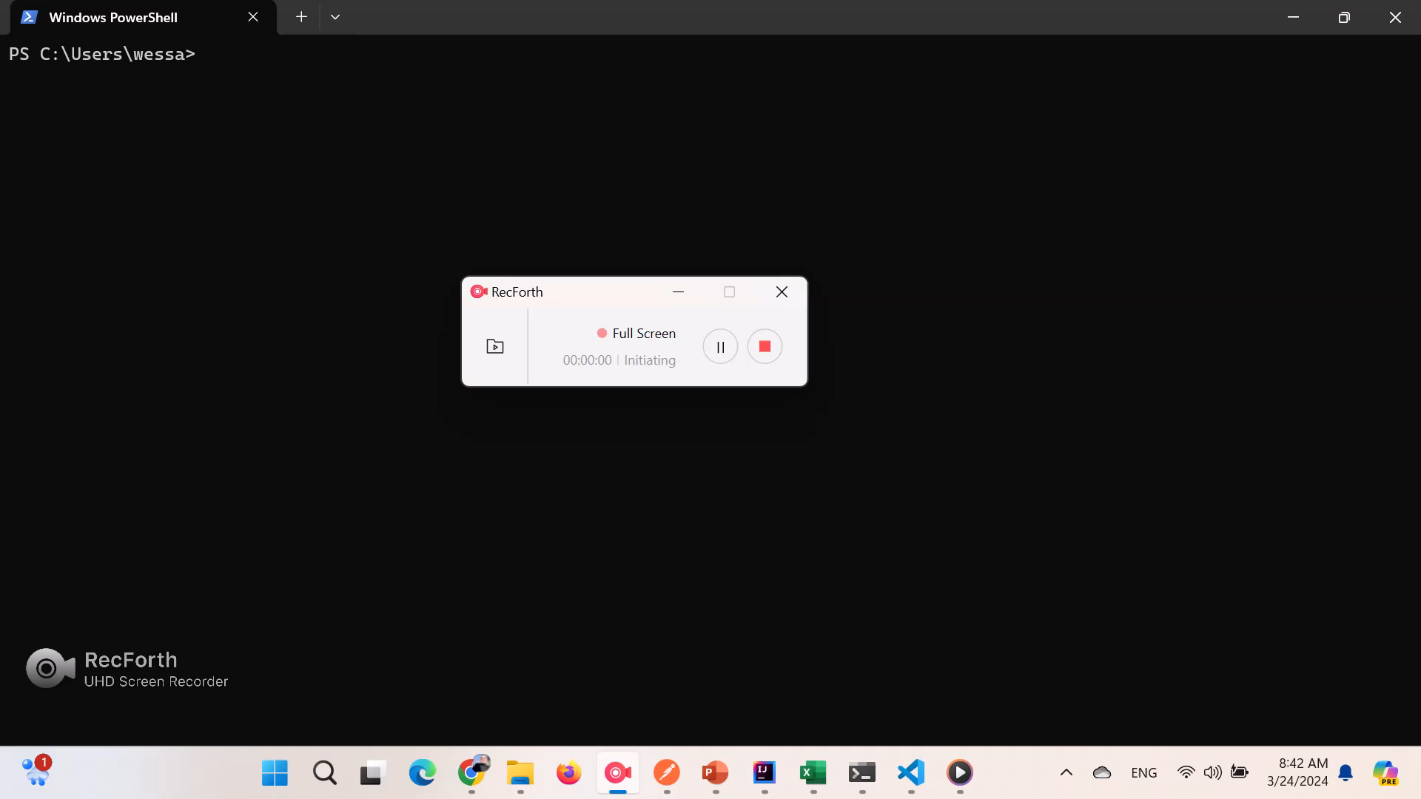

Slide 28
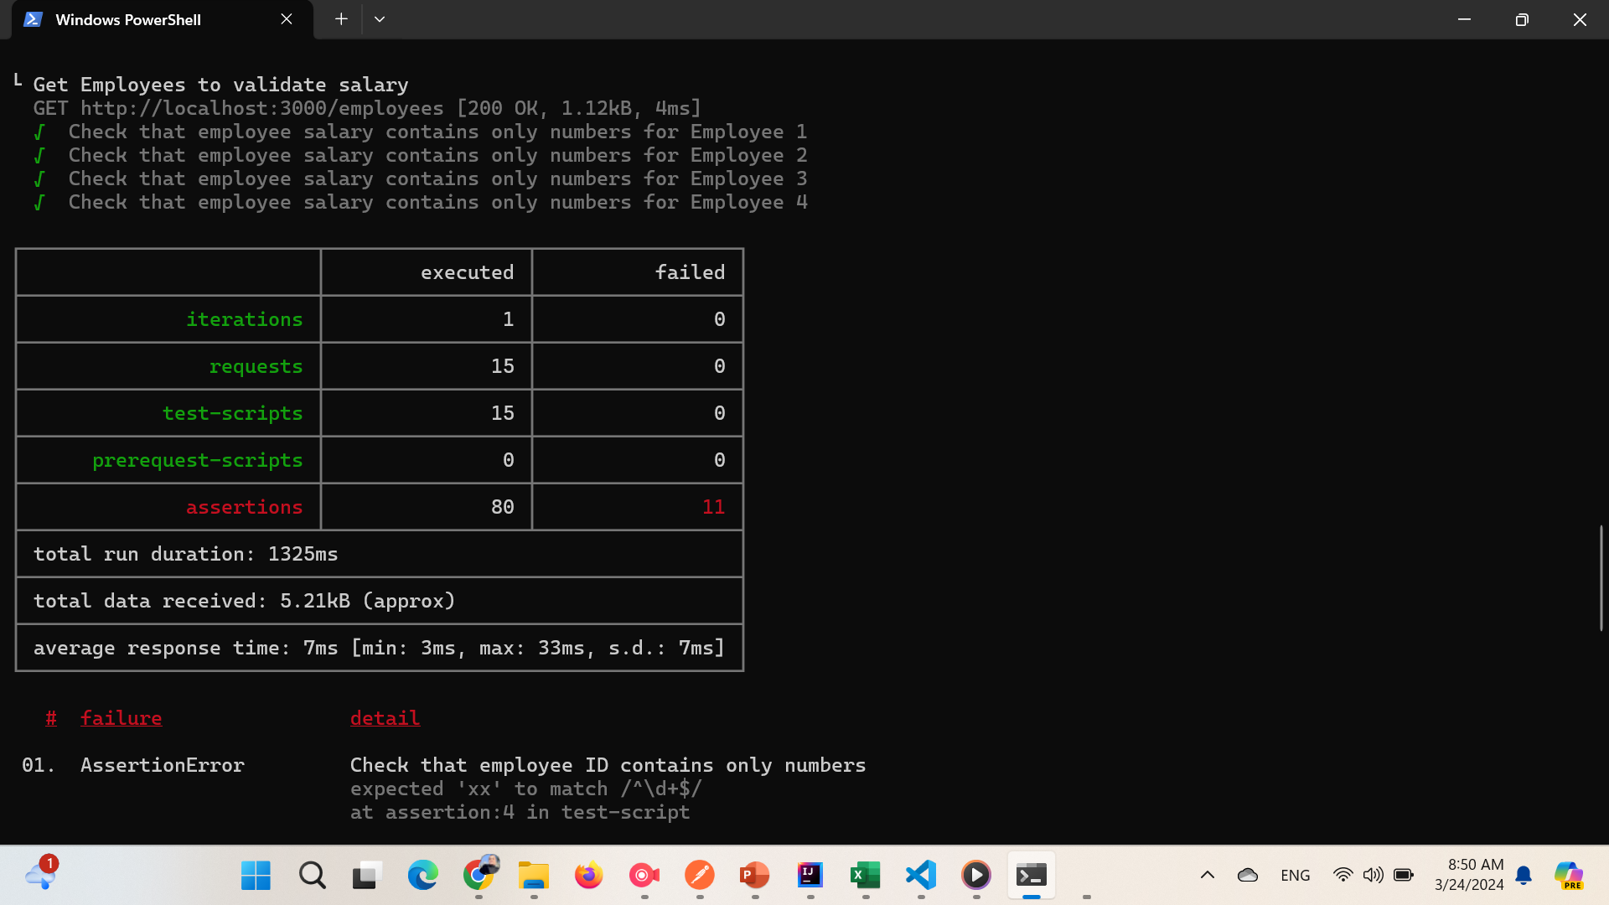
Newman Report

Slide 29
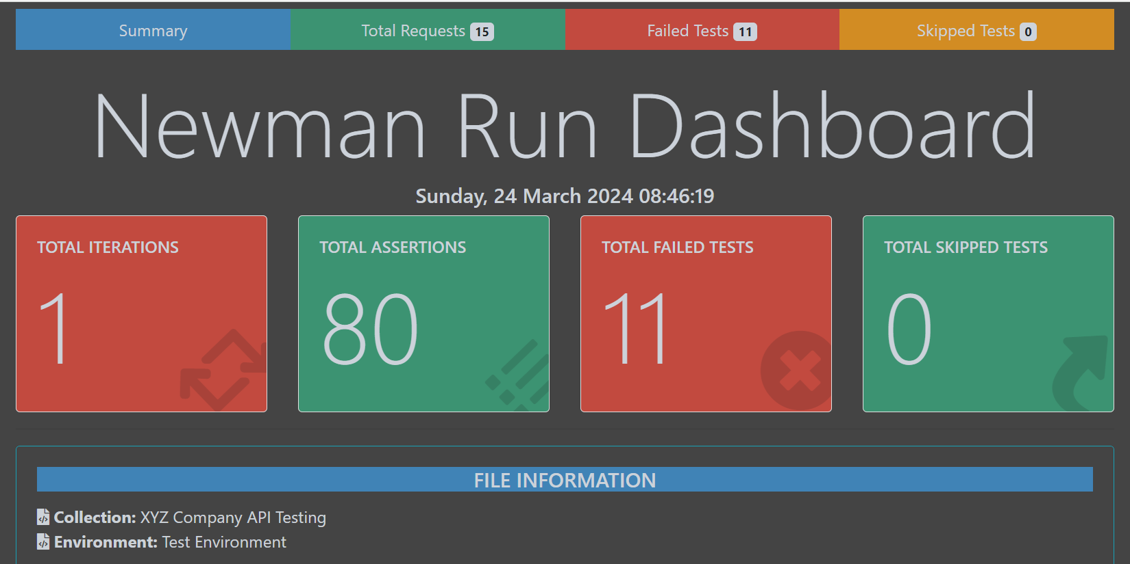
Newman HTML Report

Slide 30
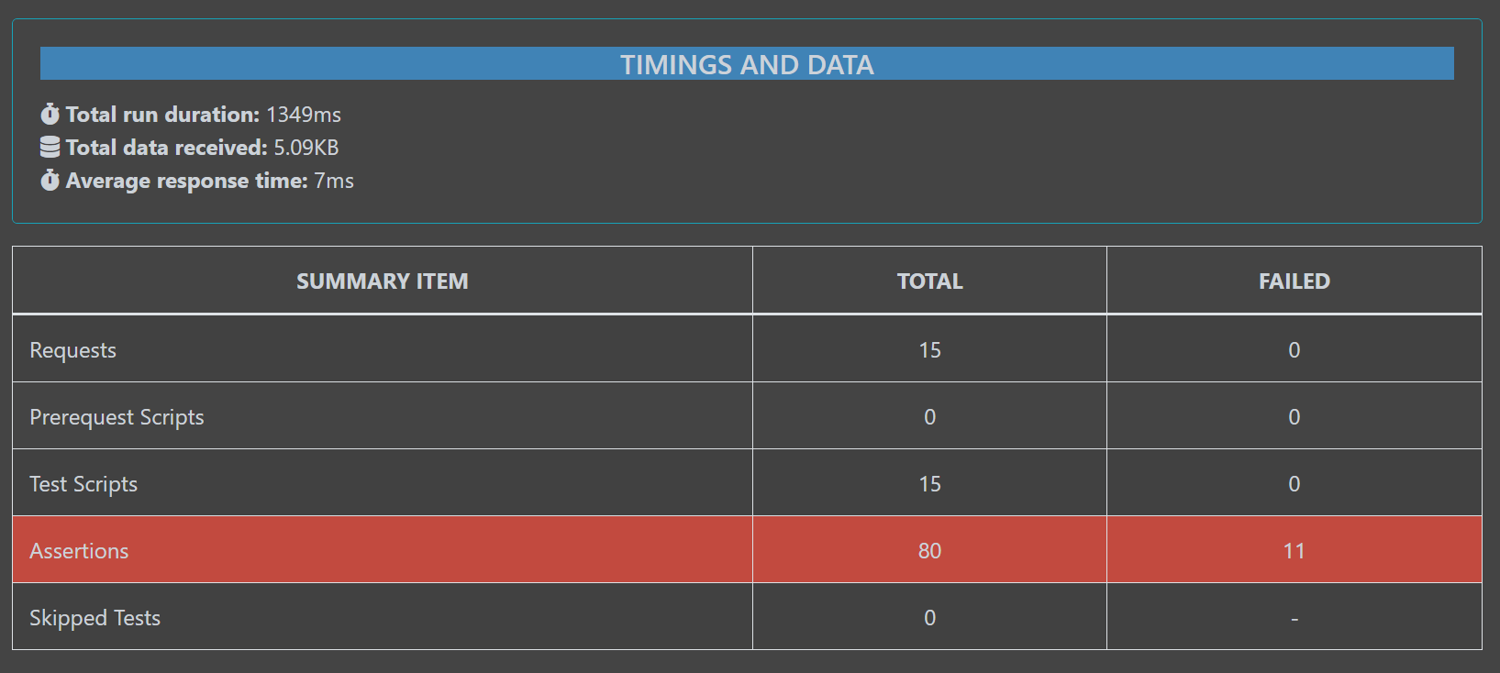
Newman HTML Report

Slide 31
Thanks!
Do you have any questions?
Wessam.y.abdulrhman@gmail.com
+201118105883

